Slide 1
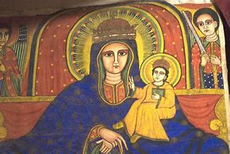
Holy Trinity University
Theology of Ethiopian Fathers
On Mariology
Facilitated By Mhr. Behailu Bekele

Slide 2
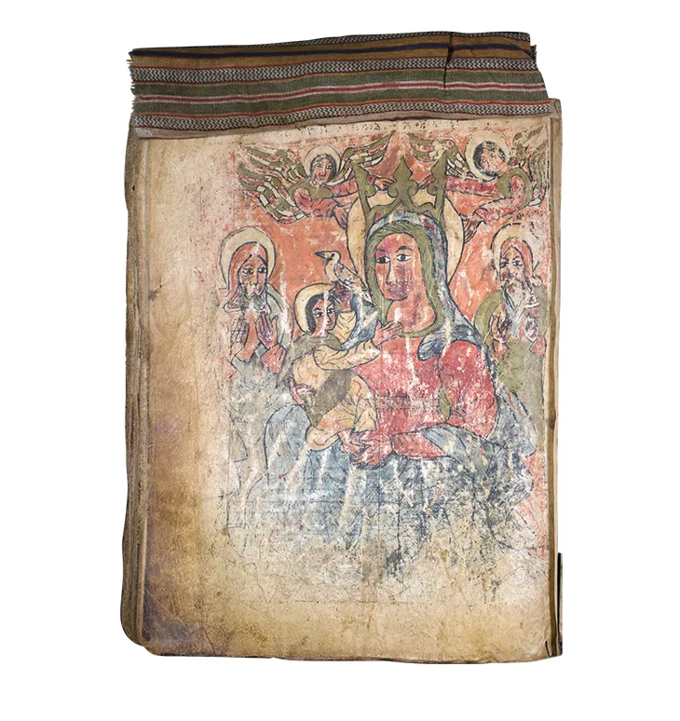
ሃሌ፡ ሉያ፡ ስብሐት ለእግዚአብሔር፡ ዘአልአላ፡ ለጽዮን፡ እምኵሉ፡ ዓለማት … ወአነሂ፡ እብል፡ ከማሆሙ፡ ሃሌ፡ ሉያ፡ ስብሐት፡ ለማኅደረ፡ በግዑ፡ ንጽሕት፡ ሌ፡ ሉያ፡ ለጽዮን፡ እምነ፡ ሥርጉት፡ በስብሐት፡ ሃሌ፡ ሉያ ለዘኢትፈቅድ፡ ፀሐየ፡ ለአብርሆታ፡ ወብርሃነ፡ በግዑ፡ ያዋኪ፡ ውስቴታ።
‘Hallelujah, glory be to the Lord who elevated Zion more than the entire world…. As for me, I said like them that ‘Glory be to the pure habitation of His Lamb. Hallelujah to Zion Our Mother adorned by praise. Hallelujah for whom does not want Sun for Her shining, and the light of His Lamb is shininginside Her’

Slide 3
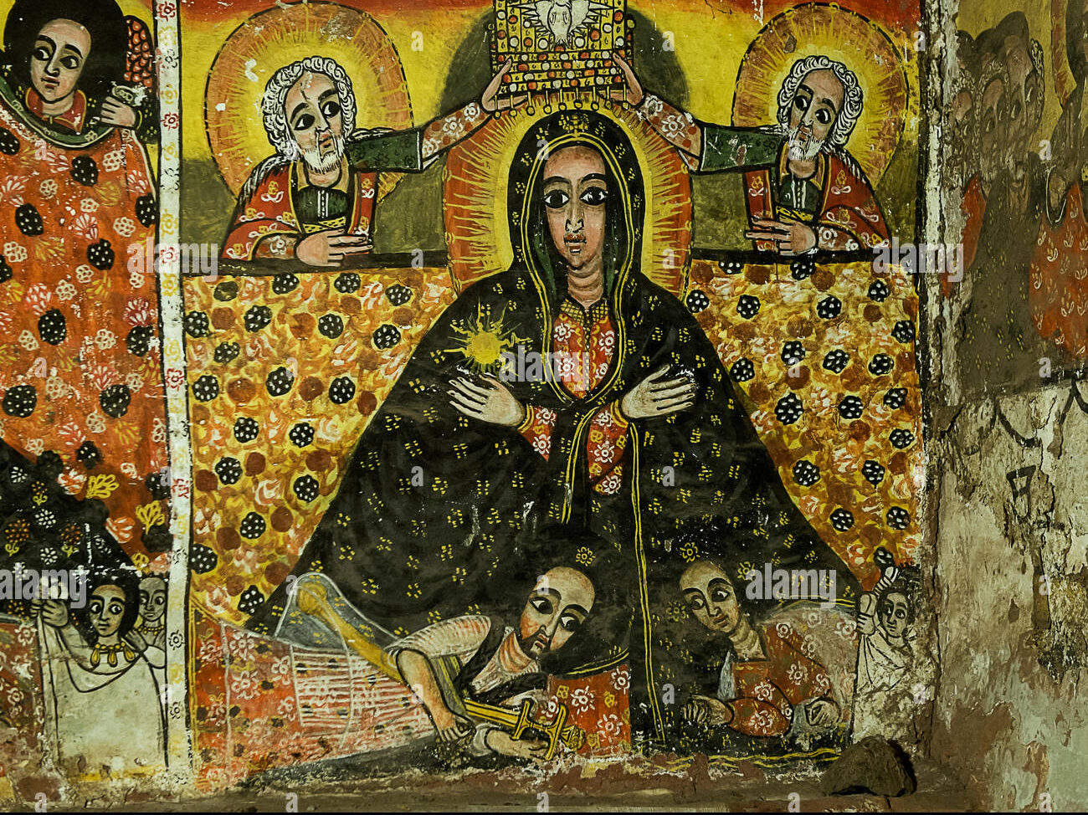
Mariology in Ethiopian Orthodox Fathers Theology
ነገረ ማርያም በኢትዮጵያ አባቶች አስተምህሮ

Slide 4
In the theology of EOTC we call her as
ወላዲተ፡ አምላክ፡ ‘the Begetter of God’/Theotokos;
ወላዲተ፡ ፈጣሪ፡ ‘Begetter of Creator’;
ወላዲተ፡ ብርሃን፡ ‘Begetter of Light’;
እመ፡ እግዚአብሔር፡ Mother of the Lord’;
ወላዲተ፡ እግዚአብሔር፡ ‘‘Begetter of the Lord’;
ድንግል፡ በክልኤ፡ ‘the two fold Virgin’;
ድንግል፡ ፍጽምት፡ ‘Perfect Virgin’;
ድንግል፡ በኲለሄ፤ ‘Perpetual Virgin’;
እኅተ፡ መላእክት፡ ‘Sister of Angels’;
ወለተ፡ ነቢያት፡ ‘Daughter of Prophets’;
እመ፡ ሐዋርያት፡ ‘Mother of the Apostles’;
ንጽሕተ፡ ንጹሐን፡ ‘the purest among the pure ones’;
ቅድስተ፡ ቅዱሳን፡ ‘the most saint among the saints’;
ቤዛዊተ፡ ዓለም፡ ‘Redeemer of the World

Slide 5
  She is viewed far beyond a mere historical figure.
  Wäladitä Amlak (ወላዲተ አምላክ): This crucial title means "Mother of God" or "God-bearer," affirming the divinity of Jesus Christ.
  Purest of All Creation: Seen as uniquely holy and set apart by God.
  Powerful Intercessor: Believers turn to her for prayers and help.
  Central to God's Plan of Salvation: Her "yes" was pivotal for the Incarnation.
Expressions of Devotion: This deep Marian devotion is expressed through:
  Rich theological treatises (deep writings by Church Fathers).
  Poetic hymns (songs of praise).
  Liturgical prayers (prayers used in church services).

Slide 6
Books which are helping in Knowing the theology of Ethiopian Fathers teaching concerning on Mariology
His Holiness Abba Paulos Dissertation feleseta ፍልሰታ
Doctrinal theology (Fr. Zemene Abuhay)
Dr. Rodas books (ነገረ ማርያም በብሉይ በሐዲስ በሊቃውንት……)
Dr. Andualem (ወላዲተ አምላክ በነገረ ድኅነት)
ወላዲተ አምላክ በኢትዮጵያ ፣ አለቃ አያሌው ታምሩ
የአባ ዘጊዮርጊስ መጻሕፍት
ርቱዐ ሃይማኖት
Getatchew Haile. “The Mariology of Emperor Zara Yaeqob of Ethiopia. Texts and Translations.” Orientalia Christina Analecta 242. 1992.
Heldman, Marilyn E. “The Marian Icons of the Painter Fre Seyon: A Study in Fifteenth-Century Ethiopian Art, Patronage, and Spirituality.” Harrassowitz (publisher) Wiesbaden (where). 1994.

Slide 7
In this section we may discus on
The place of Holy Virgin Mary in Ethiopia Orthodox Church
The teaching of Ethiopian fathers on Holy Virgin Mary
The role of Virgin Mary in the history of Human Salivation
The titles and Symbols of Holy Virgin Mary
Veneration of Holy Virgin Mary
The concept of Dormition and assumption
To learn about Holy Virgin Mary is not a simple case but it is too vast እስመ ብዙኃን ተናገሩ ለክብርኪ ……. Many church fathers also speaks about her purity
But in main concept we may think of her ….
The mystery of Divine Motherhood
He perpetual virginity of Holy Virgin Mary
Mary , the Hope of Humanity
Mary's Participation in Human redemption

Slide 8
The place of Holy Virgin Mary in Ethiopia Orthodox Church
Before we start our classroom discussion the students will discuss on the following phrases
እስመ፡ በእንቲአሃ፡ ተፈጥረ፡ ኲሉ፡ ዓለም። ‘For the whole world was created because of her

Slide 9
The place of Holy Virgin Mary in Ethiopia Orthodox Church from Abba Giorgis of Sagla
እሰግድ ለኪ ኦ እግዝእትየ ማርያም ሠርከ ወነግሀ
ወእዌድስ ማኅፀነኪ ዘአግመረ ርስነ መለኮት መፍርሀ
ኦ ንግሥት ዘአጥረይኪ ልበ ትሑተ ወመንፈሰ የዋሀ
ለወድሶትኪ ጽሑቀ ወትጉሀ
ወወጥኂ ላዕሌየ ጸዳለ ስንኪ ብሩሀ
እም አጸደ ሰላምኪ ኢይኩን ግሑሰ ወግህጉሀ
እመቤቴ ማርያም ሆይ ማታና ጠዋት እሰግድልሻለሁ
የሚያስፈራ የመለኮት ግለትን የተሸከመ ማኅፀንሽንም አመሰግናለሁ
ትሁት ልብና የዋህ መንፈስ ያተረፍሽ ንግሥት ሆይ
ለስምሽ ስብሐት ከመንቀርፈፍ እንቅልፍ ንቁ አድርጊኝ
ለምስጋናሽም የሚጥርና የሚተጋ (አድርጊኝ)
ከሰላምሽ ግቢ የተገለልኩና የተወገድኩ እንዳልሆን
ብሩሁን የውበትሽን ውጋጋን በላዬ አውርጂው

Slide 10
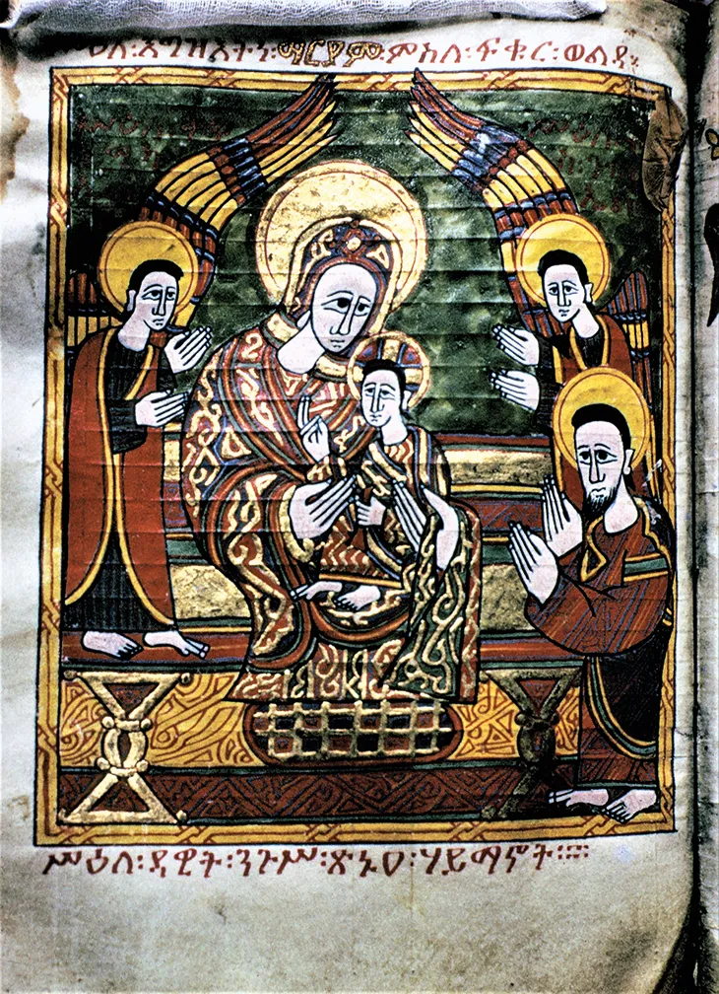
ሥዕለ ዳዊት ንጉሥ ጽኑዐ ሃይማኖት

Slide 11
The love of Emperor Dawit towards Holy Virgin Mary
በቀለመወርቅ ሶበ አሥዓለ ማርያምሃ ድንግለ፡
ኬንያሁ ረስአ ወዳሃቦ አዝሐለ፡፡
ወአመ ጸለየ አርአዮም ብአለ፡፡
ዳዊትዘኮነ በወይነ ፍቅራ ስኩረ፡፡
እስመ ለርእሱ ሰብእ ኢነሥአ ክብረ፡፡
ዘኀረዮ ብፁዕ ወልዑል ዘሰምረ፡፡
Getatchew Haile. (1983). Documents on the history of Atse Dawit (1382-1413).Journal of Ethiopian Studies. Vol. XVI. (Editor Shiferaw Bekele) IES.AAU. Addis Ababa. The Hymn is adopted from this article of Getatchew Haile.
When he had (the image of) the virgin Mary adorned with gilt, the artist thoughtlessly adulterated its gold.
When he prayed, however, (God) revealed to him the material.
Dawit was intoxicated with the wine of her love;
he did not take for himself glory (from) men.
Blessed is he whom (God) has chosen and with whom the Most High is pleased.

Slide 12
EMML 9002 አጼ ዳዊት ያጻፉት ተአምረ ማርያም ማርያም የሚለው ቃል በወርቅ ቀለም ተጽፎ ይገኛል
In double monastery located near the important pilgrimage place of Lalibela, two nuns I had been interviewing suddenly asked me, why don’t ask us about Mary? They want to tell me about how she cared fir them and answered their prayers : what ever we ask her she will give us:
A testimony of Marta Camilla Wright

Slide 13
…..
Emperor Zara Yaekob has also declared that every church should possess two tabots, and the second one must be dedicated to the Blessed Virgin.
Paulos adds that ‘One could say that Ethiopia is a country literally built around churches dedicated to the Virgin Mary. Even the churches not dedicated to St. Mary contain an extra tabot or ark which is dedicated to her
Paulos 1988:153.
ዛቲ፡ ይእቲ፡ ስመ፡ እግዝእትነ፡ ቅድስት፡ ድንግል፡ በ፪ኤ፡ ማርያም፡ ወላዲተ፡ አምላክ። አመ፡ ተጸውዐ፡ ያድለቀልቅ፡ ፅንዐ፡ ሰማያት፡ ወግዘፈ፡ ምድር፡ እስከ፡ መሰረታ፡ ለሲኦል። ወለመላእክትኒ፡ ይትሀወክ፡ ክነፊሆሙ፡ በድንጋፄ፡ ከመ፡ ቈጽል፡ አመ፡ ይዘብጦ፡ ነፋስ።
Cerruli 1943:76;

Slide 14
Atse Dawit and Abba Giorgis of Sagla
When abba Giorgis and Atse dawit fight each other by the work of enemy
After the death of king dawit Abba Giorgis mourn too much and written the situation as follows
ወሶበ ርእዩ ጽንዐ ብካዩ ይቤልዎ ምንትኑ መጠነዝ ትበኪ ዘእም ተፈሳሕከ ወእም ተሐሰይከ አኮኑ ቀሰፈከ ወሞቅሐከ ወአውስኦሙ አቡነ ጊዮርጊስ ወይቤሎሙ አንሰ እም ፈተውኩ ከመ ይሕየው ጉንዱየ ክራማተ እንዘ ይዌስክ ላዕሌየ ካዕበተ መቅሰፍተ ካልአ እም ዝንቱ እስመ ኮነ ያፈቅራ ለማርያም እግዝእትየ

Slide 15
Mariology in Ethiopia
The Book of Saints (Synaxary) of the Ethiopian Orthodox Church gives a precise definition of the cult of Our Lady Mary as Intercessor: Our Lady Mary “intercedes with her Beloved Son on behalf of the children of men and makes Him to forgive the sins of those who call upon her name.
Emperor Dawit, father of Emperor Zara Yaeqob, committed himself personally to the devotion of Our Lady Mary and to her image installed in his palace, yet the Emperor Zara Yaeqob committed his peoples, and the Church to the ritual devotions of Our Lady Mary and the commemoration of her feasts.

Slide 16
……..
In Christianity, Saint Mary Theotokos is greatly venerated. She gave birth to God's Son, Jesus Christ. Her divine motherhood exposes the meaning of God's loving response to humanity. It also demonstrates the full extent of our liberty. According to the Gospels (Luke 1:444, 30-31, 48), she is glorified by mankind.
God has saved the world through her. St. Mary is the fundamental model of humility in waiting on the Lord in her obedience. In her continuous virginity, we see the splendor of the Lord who fills all in all, 'for whom nothing is impossible.'
In the virgin birth of Our Lord, the promise and prophecy of the OT are fulfilled, and the ancient chains that bound Eve are broken by Mary's obedience. We may see the beauty of Our Lord and Savior's Incarnation in the Virgin's humble response to the celestial communication.

Slide 17
Biblical reference to Holy Virgin Mary
We have numerous Biblical references on the Blessed Virgin. Prominent Prophecies are: Gen. 3:15; Ps. 45:9-11; 87:5; 132:13-14; Isa. 7:1-17; Jer. 31:22; Ezk. 44:1-2; Mic. 5: 2-3; etc.
In the NT we read various accounts on the Blessed Virgin Mary.
  i) from the Gospels: Mtt. 1.18-25; 2: 1-23; 13:55; Mk. 6:3; Lk. 1:26- 80; 2:1-20; 11:27; Jn. 2:1-10; 19:25-27;
  ii) Acts 1:14;
  iii) Epistles: Gal. 4:4 and
  iv) Rev. 12:1-6 etc.

Slide 18
Devotion to the Blessed Virgin definitely has its roots in the early Church's existence and history. Mary was the template or example of virginity for early ascetics, and by the third century, the idea of the Virgin as the new Eve, accepted by the Council of Ephesus (431 A.D.), substantially boosted the faithful's devotion to her. Furthermore, the expansion in public piety of a belief in the Virgin's miraculous powers of intercession fostered the development of Marian devotion.
The Orthodox Churches consider the devotion of the Virgin Mary, Mother of God, to be a clear Christological imperative and an expression of the one triune God.
For Orthodox Christians, honoring Our Lord and Savior Jesus Christ entails honoring His mother, who bestowed upon Him humanity and who, in her person, symbolizes all of mankind..

Slide 19
Foundations: Where Does Ethiopian Marian Theology Come From?
Ethiopian Mariology is built upon a rich foundation drawing from two main streams:
  1. Broader Christian Tradition (Especially from Oriental Orthodoxy):
    Early Christian writings, particularly from influential centers like Alexandria (the historical mother church of the EOTC), played a significant role in shaping Ethiopian Marian thought.
  2. Indigenous Ethiopian Development:
    A vast and unique body of literature dedicated to St. Mary developed within Ethiopia, primarily written in the ancient liturgical language of Ge’ez (ግዕዝ).

Slide 20
Early Christian Influences on Ethiopian Marian Thought
  Apocryphal Texts (Popular narratives not in the biblical canon but influential):
    Protevangelium of James (attributed to James, the "brother" of the Lord): Provided narratives about Mary's early life, her parentage (Joachim and Anna), and her upbringing in the Temple.
  Visions and Devotional Works:
    Visions of St. Mary: Associated with Patriarchs Theophilos and Timothy of Alexandria, these texts fueled popular devotion and depicted her heavenly glory and intercessory power.
  Writings of Church Fathers:
    St. Cyril of Jerusalem: Wrote about Mary's life in the Temple.

Slide 21
    St. Cyril of Alexandria: His Christological writings, especially his defense against Nestorius at the Council of Ephesus (431 AD), were foundational for understanding and defending her title Theotokos (God-bearer). His works contain key terms and concepts vital for Ethiopian Mariology.
    Demetrius of Antioch: Authored a discourse (sermon/treatise) on Mary's life.
  Descriptions of Mary's Appearance & Character:
    Attributed to figures like St. Epiphanius of Cyprus (c. 320-404 AD). These descriptions, found in Ethiopian tradition (e.g., Budge, 1933), painted a picture of her dignity, humility, serene beauty, wisdom, and gentle spirit.

Slide 22
Basics of Ethiopic Mariology: Church Fathers
Protevangelium of James, James, the ‘brother’ of the Lord and first bishop of Jerusalem.
Visions of St. Mary , Theophilos and Timothy, Patriarchs of Alexandria, furthered the popular interest in the Virgin.
St. Cyril of Jerusalem writes extensively about the Virgin’s life in the Temple;
Cyril of Alexandria describes her life before the Annunciation; and
Demetrius of Antioch authors a discourse on the life of the Virgin following the Angel’s Annunciation. which was directed against the teaching of Nestorius and contains basic terms for Ethiopic Mariology.

Slide 23
The books which are found in Ethiopia about Holy Virgin Mary
The first text is መጽሐፈ፡ ልደታ፡ ለማርያም፤ ‘The Story of Mary’s nativity’,
ነገረ፡ ማርያም፤ ‘The story of Mary’- found in various form and content
መጽሐፈ፡ ዕረፍታ፡ ለማርያም፤ ‘Book of Dormition of Mary’.
መጽሐፈ፡ ዕርገታ፡ ለማርያም፤‘Book of Assumption of Mary
ድርሳነ፡ ማርያም፤ ‘Homily [in honor] of Mary’
ድርሳነ፡ ጽዮን፤ ‘Homily [in honor] of Zion’. EMML 2044,
ውዳሴ፡ ማርያም፤ ‘Praise of Mary
አንቀጸ፡ ብርሃን፤ St. Yared
ተአምረ፡ ማርያም፤
ላሃ፡ ማርያም፣
ድርሳነ፡ ፍልሰታ፣
ራእየ፡ ማርያም፡.

Slide 24
…….
መልክአ፡ ማርያም፤ Aṣe Naʾod (1494-1508), whereas Getatchew says aṣe Bäʾǝdä Maryam (1468-1478) some emperor Zara Jacob
አርጋኖን፤ አርጋኖነ፡ ውዳሴ፤ አርጋኖነ፡ ድንግል
ቅዳሴ፡ ማርያም፤
መዓዛ፡ ቅዳሴ
ማሕሌተ፡ ጽጌ፤ Canticle of the Flower
ራእየ፡ ማርያም፤ ራእየ፡ ተአምር፡ ዘዮሐንስ፡ ወልደ፡ ነጐድጓድ፡
እንዚራ፡ ስብሐት፤
መልክአ፡ ኤዶም፤
መልክአ፡ ስእል፤ ኦ፡ ርኅርኅተ፡ ኅሊና፡ it is believed that the composer is aṣe Gälawdewos (1540-1559).
ድርሳነ፡ ጽዮን፤
መልክአ፡ ጽዮን፤
መዝሙረ፡ ድንግል፤ ‘

Slide 25
……..
ሰዓታት፡ ዘሌሊት፡ ወዘነግህ፤
ሰቈቃወ፡ ድንግል፤
ስብሐተ፡ ፍቊር፤
ኆኅተ፡ ብርሃን
ውዳሴ፡ አንቀጸ፡ ነቢያት፤
የሰኔ፡ ጎልጎታ
አኮኑ፡ ብእሲ፤
ምሥጢረ፡ ጽጌያት፤
Mary have 33 celebration all annually ወበዓላቲሃኒ፡ ለእግዝእትነ፡ ማርያም፡ ፴ወ፪፡ [፴ወ፫] አዘዘ፡ ከመ፡ ያክብሩ፡ በተጠናቅቆ፡ ከመ፡ ዕለተ፡ እሑድ፡ በከመ፡ ጸሐፉ፡ ጳጳሳት፡ ወሊቃነ፡ ጳጳሳት፡ ምስለ፡ ግዘት።
The book of Synaxarium listed Meskeream 10; Ḥidar 6; Taḥsas 3; Taḥsas 28-29; Ṭirr 21; Yekkatit 16; Ginbot 1; Sene 8; Neḥase 7 and 16, also contains long passages dedicated to the Blessed Virgin Mary etc ………………..

Slide 26
Physical Appearance of Holy Virgin Mary According to Epiphanius, Bishop of Cyprus (320-404 AD)
Budge, 1933:xxiii.
ቅዱስ ኤጲፋንዮስ
መልክዐ ማርያም |ልደታ| ኪዳነምሕረት
In whatever she did, she acted with courage and dignity.
She didn't say much and only when it was very essential.
She was immediately approachable and listened well.
She honored and respected everyone, giving each person a salute.
Although some claim she was taller than average, she was of middle height.
ሰ ለቃልኪ እም አስካለ ወይን ጥዑም ወእም ድምፀ ናብሊስ አዳም ዘያረስዖ ለህማም
ሰላም ለአዕዛንኪ እለ ሰምዐ ቃሎ
ሰላም ለአዕዛንኪ ዘተበሥራ ኪዳነ
ሰላም ለቆምኪ በቀልተ ዘተመሰለ
ሰላም ለቆምኪ ወለመልእኪ ጺሚተ
ሰ ለቆምኪ አየረ ትሩፋት ዘሐፀኖ

Slide 27
………
ሰላም ለልሳንኪ ወለቃልኪ ሠናያን አምሳለ መዓር ወወይን
ሰላም ለልሳንኪ ሙኃዘ ሐሊብ ወመዓር
አፉኪ ወልሳንኪ በአኅብሮ ያቀርቡ ወትረ ለአምላከ ሰማይ ዘምሮ
ሰላም ለስእርተ ርእስኪ ዘፈትለ ሜላት ዘውጋ ወምልዕት ይእቲ እምጠለ ሰማይ እንበለ ንትጋ
ሰ. ለመልክእኪ ዘተሠርገወ አሚረ ዘያበርህ ወትረ
She was known for speaking to everyone with courage and clarity, without agitation or laughter, and she was particularly slow to become angry.
Her hair was auburn, or reddish-brown, and her complexion resembled the color of ripe wheat.

Slide 28
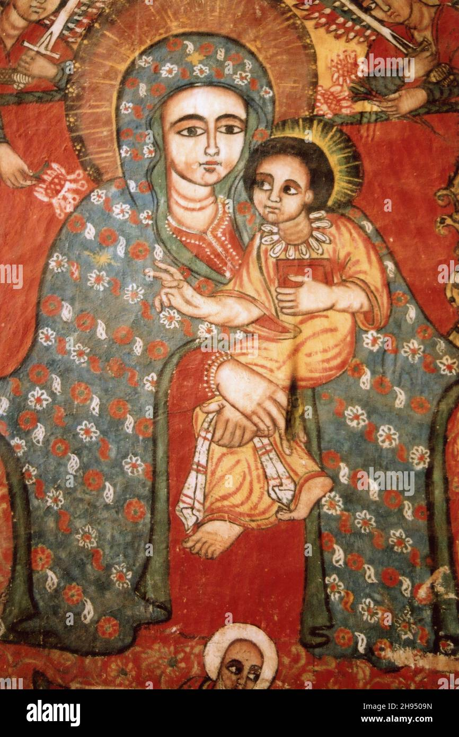
……
Her eyes were bright and keen, and light brown in color, and the pupils thereof were of an olive-green tint.
Her eyebrows were arched (or semicircular) and deep black.
Her nose was long;
her lips were red and full, and overflowing with the sweetness of her words.
The students try to fulfill the other
………………………………………………………………………………………………………………………………………………………………………………………………………………………………………………………………………………………………………………..

Slide 29
…………..
Here also the student will try to full fill the amharic or geez works of the church fathers
………………………………………………………………………………………………………………………………………………………………………………………………….
Her face was not round, but somewhat oblong (i.e. oval). Her hand was long and her fingers were long.
She was wholly free from all ostentatious pride, and she was neither stupid nor slovenly, and inclined to excessive humility.
And to sum up, she was filled with divine grace in all her ways

Slide 30
ወጽሑፍ ውስተ ሰሌዳ ልብየ መጽሐፈ ግብርናትየ ለኪ
ለአንቺ የባርነቴ መጽሐፉ በልቤ ሰሌዳ ላይ ተጽፎአል
ሐጸ ፍቅርኪ ዘደጎጾ ለልብየ ኢይትመላኅ ለዝላፉ
ልቤን የወጋው የፍቅርሽ ፍላጻ እስከ መቼውም አይነቀልም
Abba Giorgis of Sagla

Slide 31
NOW WE WILL DISCUSS THE MARIOLOGICAL THEME OF THE EOTC FATHERS
1. HER PERPETUAL VIRGINITY
2. MYSTERY OF MARY'S DIVINE MOTHERHOOD
3. MARY: HOPE OF HUMANITY
4. MARY'S PARTICIPATION IN SALIVATION OF HUMAN BEING
………………..

Slide 32
I. Perpetual virginity
ወበእንተዝ፡ ንብል፡ ማርያምሰ፡ ድንግል፡ ይእቲ፡ በክልኤ፡ ፍና፡ ድንግል፡ ይእቲ፡ በሕሊናሃ፡ ወድንግል፡ በሥጋሃ። ወአልቦ፡ ዘይትማሰሎ፡ ለድንግልና፡ ንጽሐ፡ ሕሊናሃ፡ ወለድንግልና፡ ንጽሐ፡ ሥጋሃ።
dirsane Tsion
ተፀንሰ እንዘ ኢይትአመር በከመ ይቤ ወንጌላዊ ኢያእመራ ዮሴፍ እስከ አመ ወለደት እስመ ብሁኃን ስሕቱ በእንተዝ ቃል እንዘ ይብሉ እምድኅረ ወለደት ተደመረት ምስለ ዮሴፍ ወይሰምዮሙ መጽሐፈ ኤጲፋንዮስ ለእሙንቱ መናፍቃን ፀረ ማርያም
አርጋኖነ ዉዳሴ
ሶበሰ ተወልደ እግዚእነ በሩካቤ ብእሲ ወብእሲት ዘከማነ ብዙኃን እም ተሐዘብዎ ወእም ረሰይዎ ሀሰተ
(ቅዱስ ዮሐንስ አፈወርቅ) ሀ.አበው 240

Slide 33
ኦ አንቀጸ መድኃኒት ዘኢይትረኃው መናስግቲሃ በወሊደ አምላክ ለባሴ ትስብእት (ኆኅተ ብርሃን 39.)
The blessed Ethiopian scholars speaks boldly about her perpetual virginity and they have their own expression on her “Virgin-Mother” identity.
Her virginal conception out of the law is a unique understanding in the history of the theology and salvific action of God the Son.
The Ethiopian gives a symbol of Closed door, sealed letter, unploughed land, thirsty land, Gideon fleece, etc…
ኀትምት ምድር፣ ኆኅተ ምሥራቅ ኅትምት፣ ኅቱም ኮኵህ፣ በትረ አሮን
ርደተ ጠልሰ ኀበ ፀምር ባህቲታ እንዘ ይብስት ኩላ ምድር ይተረጎም በርደተ ጠለ መለኮት ውስተ ማኅፀነ ድንግል እንዘ ኵሎን አንስት ኢ ልኩፋት እማንቱ በነጠብጣበ ኃይል ዘአርያም መጽ. ምሥ 93

Slide 34
II. Mystery of Mary's Divine Motherhood
The Ethiopian scholars employs different symbols to explain their thought of explaining the Divine motherhood of Mary like the Ark of the Covenant, the second heaven, the pure temple, the pure tabernacle,
ለእመ ኃሠሥካ ለሔዋን ትረክባ በህየ እንዘ ትትፌሳሐ በወለታ ዘአምጽአት ላቲ ፈውሰ ለቅስሊሃ
መጽ ም. 71

Slide 35
III. Mary: Hope of Humanity
This is an important theme in theology of Ethiopian fathers
The history of salivation can be characterized with fall and rise of human being and the Ethiopian church fathers examine her response to the archangel Gabriel this is her co-operation in the divine plan, presents in different symbols like country of God, the second eve, the new pitcher of Elisha, etc….

Slide 36
አመ አተውኪ ውስተ ታቦት ምስለ ቆጽለ ዘይት ሐመልሚል
ከመ አብሠርኪዮ ለኖኅ ትእምርተ ጊዜሁ ለሣህል
አብሥርኒ ጽድቀ በጸዊረ ጽጌ ጽዱል
ማርያም ርግበ ቁስቋም ዘአክናፍኪ መስቀል
መጽ ሰዓ 230፣ ዕን ስብ 39፣ ማኅ ጽጌ

Slide 37
IV. Mary's Participation in Human Redemption
Mary's participation and human redemption is seen differently the Ethiopian explains the descent of Logos to earth united in the womb of Mary and ascent of Humanity to heaven with the flesh of Mary; has its own cause that cause is Holy Virgin Mary.
The Ethiopian church fathers gives a symbol also for this theological ideology like Etse sabeq for the Lamb of God, mother of the bridegroom, Etse Hiwot tree of life, etc….

Slide 38
መኑ ረሰያ ለዕጸ ሳቤቅ ከመ ትለድ በግዐ ዘእንበለ ሩካቤ፡፡እብልሰ በግዕ ዘቤዘዎ ለይስሐቅ አርአያ ወአምሳል፡፡ በግዕ ዘሀሎ ውስተ ከርስየ በግዕ ዘበአማን ዘበእንቲአሁ ይቤ ኢሳይያስ መጽአ ይጠባሕ ከመ በግዕ፤ ወከመ በግዕ ዘይነብብ በቅድመ ዘይቀርፆ
አባ ጊዮ. 8 ዕን ስብ 66
ኦ ድንግል መፍርይት ለእንተ ይትበላዕ ወመንቅዕት ለእንተ ይሰተይ
ኦ ጽዋዕ እንተ እምኔኪ ለእለ ይሰትዩ እምኔሁ በአሚን ዘያጎስዕ ጥበበ ወይሁብ ሕይወተ
ቅዳ ማር አንድምታ ገ 162

Slide 39
Symbols of Holy Virgin Mary
ተቅዋመ፡ ማኅቶት፡ ዘወርቅ፡ ‘[You are] the golden lamp stand
ወታቦትሰ፡ ንጽሕት፡ ይእቲ፡ እግዝእትነ፡ ማርያም፡ ዘይትማሰላ፡ አልቦ፡ ኢሰማያውያን፡ ወኢምድራውያን። ‘And as for the Tablet, she is our Lady Mary the Pure, against whom there is no one equating with Her neither from the celestials nor from the terrestrials’
ሀገሩ፡ ለንጉሥ፡ ዓቢይ፡ ‘[You are] the country of the great king’
መርዓተ፡ ሊባኖስ፡ ዘትመስል፡ አትሮንሰ፡ ዘአበ፡ ሮብአም፡ ‘Bride of Lebanon, which seems the throne of father of Rehoboam’

Slide 40
Symbols of virgin Mary from Ethiopian fathers
  ኆኅተ ብርሃን
  ዲበ ኩሉ አሠልጠና
  ወዲበ ኩሉ አስፈና
  ይእቲመ ኮነት መሠረተ ለቅድስና
  ዘወለደት አምላከ በድንግልና
መድኃኒቱ ለአዳም፣ ዳግሚት ሔዋን፣ ወምዉካፈ መሥዋዕቱ ለአቤል፣ ወመስተባዝኂተ አዝርእቲሁ ለሴት፣ ሕይወተ ነፍሱ ለሄኖክ፣ ወኑኀ መዋዕሊሁ ለማቱሳላ፣ ዕረፍቱ ለላሜህ፣ ወታቦት እንተ ኖኅ በዘቦቱ ድኅኑ ሰማኒቱ ነፍስ እምአስራበ አይኅ (ሐመረ ኖኅ)፣ ሀብተ ጸጋሁ ለሴም፣ በሀብተ ቡራኬሁ ለያፌት፣ ወመስተስርይተ መርገሙ ለካም፣ ሞጻሕተ መሥዋዕቱ ለመልከ ጼዴቅ፣ ገራሕተ ስሙር ዘአብርሃም፣ መድኃኒቱ ለይስሐቅ፣ ሠዋስወ ወርቅ ዘያዕቆብ፣ ዕፀ ሳቤቅ ዘይስሐቅ ፣ ዕጸ ጳጦስ ዘሲና፣ በትረ አሮን፣ ሐውልተ ስምዕ ዘኢያሱ፣ ፀምረ ጌድዮን፣ ኆኅተ ሕዝቅኤል፣ ……….መርዐት ሠናይት ዘሰሎሞን ፣ ልዑለ ቃል ዘኢሳይያስ፣ ትንቢተ ሚክያስ፣ ዕብነ ዳንኤል፣ …………

Slide 41
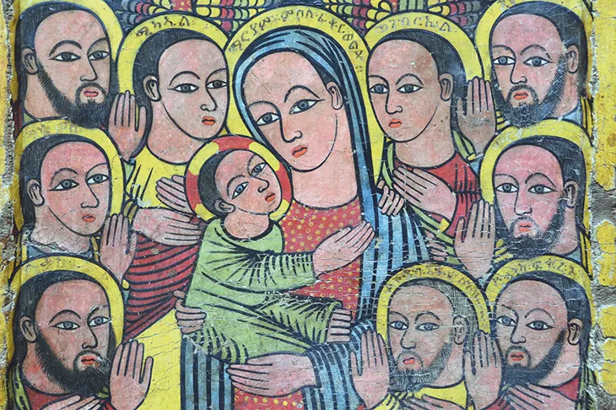
ኀቤኪ ኅሊናየ አስመከ ወብኪ ልብየ ተወከለ
ክድንኒ ግርማ ወአሠርግውኒ ሣህለ

Slide 42
የ10 ደቂቃ ውይይት ለተማሪዎች በሁለት ግሩፕ Some Controversial points in immaculate conception
የአንጽሐ ቡድን
የዐቀባ ቡድን
አቡነ ሺኖዳ (ከግብጽ) pope shenouda III series 2 1999, the holy Virgin Mary P.10.
በአምላኪየ ወመድኀኒየ (ሉቃ)
አቡነ ጳውሎስ (ከኢትዮ) aba paulos filseta p. 306
መጋቤ ብሉይ ሰይፈ ሥላሴ ዮሐንስ (መሠረተ ሃይማኖትና የካህናት ተልዕኮ 1982 ገ. 29)
በወቅቱ በጳውሎስ ደቀመዛሙርት ክስ መጽሐፉ ከሥርጭት ተቋርጧል
ሰፍሖ ገብረ እም ጥንተ ሥጋሁ ለአዳም ቅ. ማ 64
ማርያምሰ ተሐቱ ውስተ ከርሱ ለአዳም ከመ ባሕርይ ጸዓዳ ድ. 94፣326.379
አቡነ ማቲያስ አሠተርአየ ጽጌን አሜሪካ ላይ ክህነቱን ሲይዙ ያስተላለፉት አንድ ነጥብ የነብዩ ኤርሚያስን መጠበቅ ነው፡፡
አኮ ዘመጽአ ላዕሌሃ መንፈስ ቅዱስ ዘከመ መጽአ ላዕለ ነቢያት ወሐዋርያት ወላዕለ ኮሎሙ መኃይምናን ለቀድሶ ነፍሶሙ ወሥጋሆሙ

Slide 43
አንጺሖ ሠጋሃ፣ ቀዲሶ ኪያሃ፣
ነፍሳ ቀደስከ ወሥጋሃ አንጻሕከ (ያዕቆብ ዘሥሩግ ቁ 21 )
ለማርያምሰ እም ከርሰ እማ ቀደሳ ወአንጽሐ መንፈስ ቅዱስ በቅዳሴ ወንጽሕ ዘኢይትነገር
መጋቤ ብሉይ ሠይፈ ሥላሴ (ትንሣኤ መጽሔት ቁ. 23 1971 ላይ ጥንተ አብሶ የለባትም ብለው ጽፈው ነበር)
እምሰዶም እምኮነ፣ ወከመ ገሞራ እመሰልነ፣ እግዚአብሔር ኪያኪ እመ ኢያትረፈ ለነ፣ በትረ ማርያም እንተ ጸገይኪ መድኅነ፣ ዘይቤ ኢመጻእኩ እጸውእ ጻድቃነ፣ አላ ለንስሐ ኃጥአነ
አባ ጽጌ ድንግል
እመቤታችን ጥንተ አብሶ የለባትም (1988 የኢኦተቤክ እምነት ሥርዓተ አምልኮና የውጪ ግንኙነት መጽሐፍ)
ዓሥራት ገብረ ማርያም በትምህርተ መለኮት መጽሐፋቸው
  1983 አለባት
  19991 የተጻፈውን አጥፍተዋል
አቡነ መልከ ጼዴቅ (የኢ. ኦ. ተ. ቤክ. እምነትና ሥርዓት ገ. 146)
በ1988 ቅዱስ ሲኖዶስ መንፈስ ቅዱስ ዐቀባ እምከርሰ እማ የሚል አዋጅ አወጀ

Slide 44
What is the position of the Ethiopian Church
Our lady, the virgin Mary who conceived and begot Christ in Virginity is free from the Original sin from the descendants of Adam, clean from any sins of the flesh or soul; embedded in the concise of God before time of her birth, free and protected from human desires and frailty; and the choicest from among the chosen. Such is the Virgin Mary pure and holy of holies
አምላክን በድንግልና ጸንሳ በድንግልና የወለደች እመቤታችን ድንግል ማርያም ከአዳም የተላለፈ ኃጢአት \ጥንተ አብሶ ያለገኛት\ መርገመ ሥጋ መርገመ ነፍስ የሌለባት ከመውለዷ አስቀድሞ በአምላክ ኅሊና ትኖር የነበረች በሰው ልማድና ጠባይ ከሚደርሰው ሥጋዊ አሳብና ፈቃድ ሁላ የተጠበቀች ከተለዩ የተለየች ንጽሕት ቅድስተ ቅዱሳን ናት፡፡

Slide 45
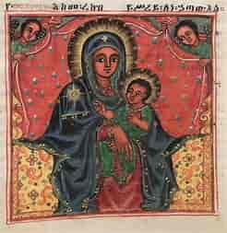
ኦ፡ እግዝእትነ፡ ማርያም፡ ፀወነ፡ ብዙኃን፡ አእላፍ፤
ረድኤቶሙ፡ አንቲ፡ ለእለ፡ ውስተ፡ ባሕር፡ ወጸድፍ፤
ርድእኒ፡ ጊዜ፡ ወዲቅ፡ ወአንሥእኒ፡ በክንፍ፤
እስመ፡ አነ፡ ገብርኪ፡ …… አፈቅረኪ፡ እም፡ ውሳጤ፡ ልብየ፡ ወአኮ፡ በአፍ፤
ለዓለመ፡ ዓለም፡ አሜን።

Slide 46
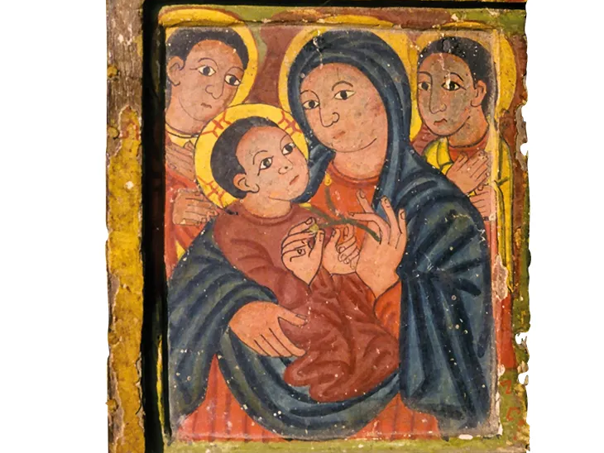
FINISHED …………
Our beloved Mother, mother of the whole world

